Slide 1
Session 10 : Android GUI Programming
Module 4.3 : Android

Slide 2
Learning Objectives
At the end of the session successful participants will be able to
Create basic GUI components in Android applications

Slide 3
Android GUI Programming
A Detailed List of Widgets
AbsListView AbsListView.LayoutParams AbsoluteLayout AbsoluteLayout.LayoutParams AbsSeekBar AbsSpinner AdapterView<T extends Adapter> AdapterContextMenuInfo AlphabetIndexer AnalogClock ArrayAdapter<T> AutoCompleteTextView BaseAdapter BaseExpandableListAdapter Button CheckBox CheckedTextView Chronometer CompoundButton CursorAdapter CursorTreeAdapter DatePicker DialerFilter DigitalClock | EditText ExpandableListView ExpandableListContextMenuInfo Filter Filter.FilterResults FrameLayout FrameLayout.LayoutParams Gallery Gallery.LayoutParams GridView HeaderViewListAdapter HorizontalScrollView ImageButton ImageSwitcher ImageView LinearLayout LinearLayout.LayoutParams ListView ListView.FixedViewInfo MediaController MultiAutoCompleteTextView CommaTokenizer PopupWindow ProgressBar

Slide 4
Android GUI Programming
A Detailed List of Widgets
RadioButton RadioGroup RadioGroup.LayoutParams RatingBar RelativeLayout RelativeLayout.LayoutParams RemoteViews ResourceCursorAdapter ResourceCursorTreeAdapter Scroller ScrollView SeekBar SimpleAdapter SimpleCursorAdapter SimpleCursorTreeAdapter SimpleExpandableListAdapter SlidingDrawer Spinner TabHost | TabHost.TabSpec TableLayout TableLayout.LayoutParams TableRow TableRow.LayoutParams TabWidget TextSwitcher TextView TextView.SavedState TimePicker Toast ToggleButton TwoLineListItem VideoView ViewAnimator ViewFlipper ViewSwitcher ZoomButton ZoomControls
http://developer.android.com/reference/android/widget/package-summary.html (for detailed list)

Slide 5
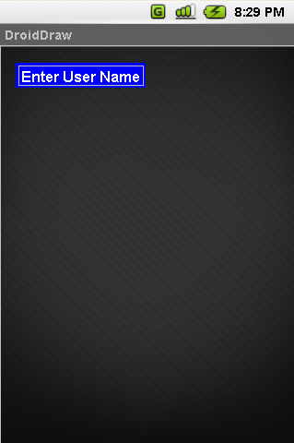
Android GUI Programming
Basic Widgets: Labels
A label is called in android a TextView.
TextViews are typically used to display a caption.
TextViews are not editable, therefore they take no input.

Slide 6
Android GUI Programming
Basic Widgets: Labels
<?xml version="1.0" encoding="utf-8"?>
<AbsoluteLayout
android:id="@+id/absLayout"
android:layout_width="fill_parent" android:layout_height="fill_parent"
xmlns:android="http://schemas.android.com/apk/res/android"
>
<TextView
android:id="@+id/myTextView1"
android:layout_width="wrap_content"
android:layout_height="wrap_content"
android:background="#ff0000ff"
android:padding="3px"
android:text="Enter User Name”

Slide 7
Android GUI Programming
Basic Widgets: Labels
android:textSize="16sp"
android:textStyle="bold"
android:gravity="center"
android:layout_x="20px"
android:layout_y="22px“ >
</TextView>
</AbsoluteLayout>

Slide 8
Android GUI Programming
Basic Widgets: Labels/TextViews
Attribute Name | Related Method | Description
android:autoLink | setAutoLinkMask(int) | Controls whether links such as urls and email addresses are automatically found and converted to clickable links.
android:autoText | setKeyListener(KeyListener) | If set, specifies that this TextView has a textual input method and automatically corrects some common spelling errors.
android:bufferType | setText(CharSequence,TextView.BufferType) | Determines the minimum type that getText() will return.
android:capitalize | setKeyListener(KeyListener) | If set, specifies that this TextView has a textual input method and should automatically capitalize what the user types.
android:cursorVisible | setCursorVisible(boolean) | Makes the cursor visible (the default) or invisible Must be a boolean value, either "true" or "false".
android:digits | setKeyListener(KeyListener) | If set, specifies that this TextView has a numeric input method and that these specific characters are the ones that it will accept.
android:drawableBottom | setCompoundDrawablesWithIntrinsicBounds(Drawable,Drawable,Drawable,Drawable) | The drawable to be drawn below the text.

Slide 9
Android GUI Programming
Basic Widgets: Labels/TextViews
Attribute Name | Related Method | Description
android:drawableLeft | setCompoundDrawablesWithIntrinsicBounds(Drawable,Drawable,Drawable,Drawable) | The drawableto be drawn to the left of the text.
android:drawablePadding | setCompoundDrawablePadding(int) | The padding between the drawables and the text.
android:drawableRight | setCompoundDrawablesWithIntrinsicBounds(Drawable,Drawable,Drawable,Drawable) | The drawable to be drawn to the right of the text.
android:drawableTop | setCompoundDrawablesWithIntrinsicBounds(Drawable,Drawable,Drawable,Drawable) | The drawable to be drawn above the text.
android:editable |  | If set, specifies that this TextView has an input method.

Slide 10
User Interfaces Using XML Layouts
Basic Widgets: Labels/TextViews
Attribute Name | Related Method | Description
android:editorExtras | setInputExtras(int) | Reference to an <input-extras>XML resource containing additional data to supply to an input method, which is private to the implementation of the input method.
android:ellipsize | setEllipsize(TextUtils.TruncateAt) | If set, causes words that are longer than the view is wide to be ellipsized instead of broken in the middle.
android:ems | setEms(int) | Makes the TextView be exactly this many ems wide Must be an integer value, such as "100".
android:freezesText | setFreezesText(boolean) | If set, the text view will include its current complete text inside of its frozen icicle in addition to meta-data such as the current cursor position.
android:gravity | setGravity(int) | Specifies how to align the text by the view's x and/or y axis when the text is smaller than the view.

Slide 11
Android GUI Programming
Basic Widgets: Labels/TextViews
Attribute Name | Related Method | Description
android:height | setHeight(int) | Makes the TextView be exactly this many pixels tall.
android:hint | setHint(int) | Hint text to display when the text is empty.
android:imeActionId | setImeActionLabel(CharSequence,int) | Supply a value for EditorInfo.actionIdused when an input method is connected to the text view.
android:imeActionLabel | setImeActionLabel(CharSequence,int) | Supply a value for EditorInfo.actionLabelused when an input method is connected to the text view.
android:imeOptions | setImeOptions(int) | Additional features you can enable in an IME associated with an editor, to improve the integration with your application.
android:includeFontPadding | setIncludeFontPadding(boolean) | Leave enough room for ascenders and descenders instead of using the font ascent and descent strictly.
android:inputMethod | setKeyListener(KeyListener) | If set, specifies that this TextView should use the specified input method (specified by fully-qualified class name).
android:inputType | setRawInputType(int) | The type of data being placed in a text field, used to help an input method decide how to let the user enter text.

Slide 12
Android GUI Programming
Basic Widgets: Labels/TextViews
Attribute Name | Related Method | Description
android:lineSpacingExtra | setLineSpacing(float,float) | Extra spacing between lines of text.
android:lineSpacingMultiplier | setLineSpacing(float,float) | Extra spacing between lines of text, as a multiplier.
android:lines | setLines(int) | Makes the TextView be exactly this many lines tall Must be an integer value, such as "100".
android:linksClickable | setLinksClickable(boolean) | If set to false, keeps the movement method from being set to the link movement method even if autoLink causes links to be found.
android:marqueeRepeatLimit | setMarqueeRepeatLimit(int) | The number of times to repeat the marquee animation.
android:maxEms | setMaxEms(int) | Makes the TextView be at most this many ems wide Must be an integer value, such as "100".
android:maxHeight | setMaxHeight(int) | Makes the TextView be at most this many pixels tall Must be a dimension value, which is a floating point number appended with a unit such as "14.5sp".

Slide 13
Android GUI Programming
Basic Widgets: Labels/TextViews
Attribute Name | Related Method | Description
android:maxWidth | setMaxWidth(int) | Makes the TextView be at most this many pixels wide Must be a dimension value, which is a floating point number appended with a unit such as "14.5sp".
android:minEms | setMinEms(int) | Makes the TextView be at least this many ems wide Must be an integer value, such as "100".
android:minHeight | setMinHeight(int) | Makes the TextView be at least this many pixels tall Must be a dimension value, which is a floating point number appended with a unit such as "14.5sp".
android:minLines | setMinLines(int) | Makes the TextView be at least this many lines tall Must be an integer value, such as "100".
android:minWidth | setMinWidth(int) | Makes the TextView be at least this many pixels wide Must be a dimension value, which is a floating point number appended with a unit such as "14.5sp".

Slide 14
Android GUI Programming
Basic Widgets: Labels/TextViews
Attribute Name | Related Method | Description
android:numeric | setKeyListener(KeyListener) | If set, specifies that this TextView has a numeric input method.
android:password | setTransformationMethod(TransformationMethod) | Whether the characters of the field are displayed as password dots instead of themselves.
android:phoneNumber | setKeyListener(KeyListener) | If set, specifies that this TextView has a phone number input method.
android:privateImeOptions | setPrivateImeOptions(String) | An addition content type description to supply to the input method attached to the text view, which is private to the implementation of the input method.
android:scrollHorizontally | setHorizontallyScrolling(boolean) | Whether the text is allowed to be wider than the view (and therefore can be scrolled horizontally).
android:selectAllOnFocus | setSelectAllOnFocus(boolean) | If the text is selectable, select it all when the view takes focus instead of moving the cursor to the start or end.
android:shadowColor | setShadowLayer(float,float,float,int) | Place a shadow of the specified color behind the text.
android:shadowDx | setShadowLayer(float,float,float,int) | Horizontal offset of the shadow.

Slide 15
Android GUI Programming
Basic Widgets: Labels/TextViews
Attribute Name | Related Method | Description
android:shadowDy | setShadowLayer(float,float,float,int) | Vertical offset of the shadow.
android:shadowRadius | setShadowLayer(float,float,float,int) | Radius of the shadow.
android:singleLine | setTransformationMethod(TransformationMethod) | Constrains the text to a single horizontally scrolling line instead of letting it wrap onto multiple lines, and advances focus instead of inserting a newline when you press the enter key.
android:text | setText(CharSequence) | Text to display.
android:textColor | setTextColor(ColorStateList) | Text color.
android:textColorHighlight | setHighlightColor(int) | Color of the text selection highlight.
android:textColorHint | setHintTextColor(int) | Color of the hint text.
android:textColorLink | setLinkTextColor(int) | Text color for links.

Slide 16
Android GUI Programming
Basic Widgets: Labels/TextViews
Attribute Name | Related Method | Description
android:textScaleX | setTextScaleX(float) | Sets the horizontal scaling factor for the text Must be a floating point value, such as "1.2".
android:textSize | setTextSize(float) | Size of the text.
android:textStyle | setTypeface(Typeface) | Style (bold, italic, bolditalic) for the text.
android:typeface | setTypeface(Typeface) | Typeface (normal, sans, serif, monospace) for the text.
android:width | setWidth(int) | Makes the TextViewbe exactly this many pixels wide.

Slide 17
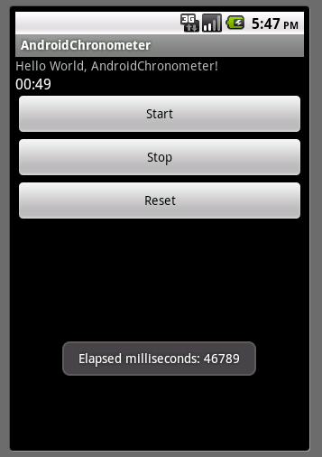
Android GUI Programming
Basic Widgets: Buttons
A Button widget allows the simulation of a clicking action on a GUI.
Button is a subclass of TextView. Therefore formatting a Button’s face is similar to the setting of a TextView.

Slide 18
Android GUI Programming
Basic Widgets: Buttons
...
<Button
android:id="@+id/btnExitApp"
android:layout_width="wrap_content"
android:layout_height="wrap_content"
android:padding="10px"
android:layout_marginLeft="5px"
android:text="Exit Application"
android:textSize="16sp"
android:textStyle="bold"
android:gravity="center"
android:layout_gravity="center_horizontal"
>
</Button>

Slide 19
Android GUI Programming
Basic Widgets: Buttons
Try
Implement any/all of the following projects using simple text boxes (EditText, TextView) and buttons:
Currency calculator
Tip calculator
Simple flashlight

Slide 20
Android GUI Programming
Basic Widgets: Images
ImageView and ImageButton are two Android widgets that allow embedding of images in your applications.
Both are image-based widgets analogue to TextView and Button, respectively.
Each widget takes an android:src or android:background attribute (in an XML layout) to specify what picture to use.

Slide 21
Android GUI Programming
Basic Widgets: Images
Pictures are usually reference a drawable resource.
You can also set the image content based on a URI from a content provider via setImageURI().
ImageButton, is a subclass of ImageView. It adds the standard Button behavior for responding to click events.

Slide 22
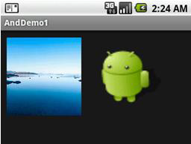
Android GUI Programming
Basic Widgets: Images
...
<ImageButton
android:id="@+id/myImageBtn1"
android:background="@drawable/default_wallpaper"
android:layout_width="125px"
android:layout_height="131px“
></ImageButton>
<ImageView
android:id="@+id/myImageView1"
android:background="@drawable/ic_launcher_android"
android:layout_width="108px"
android:layout_height="90px“
></ImageView>

Slide 23
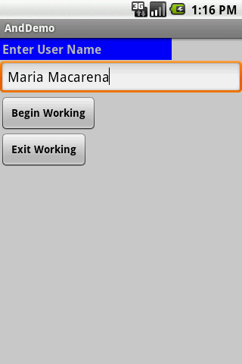
Android GUI Programming
Basic Widgets: EditText
The EditText(or textBox) widget is an extension of TextView that allows updates.
The control configures itself to be editable.
Important Java methods are: txtBox.setText(“someValue”) and txtBox.getText().toString()

Slide 24
Android GUI Programming
Basic Widgets: EditText
In addition to the standard TextView properties EditText has many others features such as:
android:autoText | (true/false) provides automatic spelling assistance
android:capitalize | (words/sentences) automatic capitalization
android:digits | to configure the field to accept only certain digits
android:singleLine | is the field for single-line / multiple-line input
android:password | (true/false) controls field’s visibility
android:numeric | (integer, decimal, signed) controls numeric format
android:phonenumber | (true/false) Formatting phone numbers

Slide 25
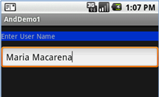
Android GUI Programming
Example: Basic Widgets: EditText
...
<EditText
android:id="@+id/txtUserName"
android:layout_width="fill_parent"
android:layout_height="wrap_content"
android:textSize="18sp"
android:autoText="true"
android:capitalize="words"
android:hint="First Last Name"
>
</EditText>
...

Slide 26
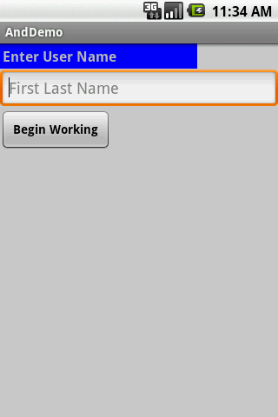

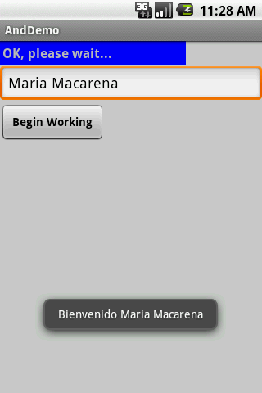
Android GUI Programming
Example: Basic Widgets
In this little example we will use an AbsoluteLayout holding a label(TexView), a textBox(EditText), and a Button. We will use the view as a sort of simplified login screen.

Slide 27
Android GUI Programming
Example: Basic Widgets
<?xml version="1.0" encoding="utf-8"?> <LinearLayout android:id="@+id/linearLayout" android:layout_width="fill_parent" android:layout_height="fill_parent" android:background="#ffcccccc" android:orientation="vertical" xmlns:android="http://schemas.android.com/apk/res/android" >
<EditText android:id="@+id/txtUserName" android:layout_width="fill_parent" android:layout_height="wrap_content" android:textSize="18sp" android:autoText="true" android:capitalize="words" android:hint="First Last Name" > </EditText> <Button android:id="@+id/btnBegin" android:layout_width="wrap_content”

Slide 28
Android GUI Programming
Example: Basic Widgets
<TextView android:id="@+id/labelUserName" android:layout_width="227px" android:layout_height="wrap_content" android:background="#ff0000ff" android:padding="3px" android:text="Enter User Name" android:textSize="16sp" android:textStyle="bold" > </TextView>
android:layout_height="wrap_content" android:text=" Begin Working " android:textSize="14px" android:textStyle="bold" > </Button> </LinearLayout>

Slide 29
Android GUI Programming
Example: Basic Widgets
Android’s Application
Package cis493.gui;
Import android.app.Activity;
Import android.os.Bundle;
Import android.view.View;
Import android.view.View.OnClickListener;
Import android.widget.Button;
Import android.widget.EditText;
Import android.widget.TextView;
Import android.widget.Toast;
////////////////////////////////////////////////////////////////////////
// "LOGIN" -a gentle introduction to UI controls

Slide 30
Android GUI Programming
Example: Basic Widgets
Android’s Application
publicclassAndDemoextendsActivity {TextViewlabelUserName;
EditTexttxtUserName;
Button btnBegin;
@Override
publicvoidonCreate(Bundle savedInstanceState) {
super.onCreate(savedInstanceState);
setContentView(R.layout.main);
//binding the UI's controls defined in "main.xml" to Java code
labelUserName= (TextView) findViewById(R.id.labelUserName);
txtUserName= (EditText) findViewById(R.id.txtUserName);
btnBegin= (Button) findViewById(R.id.btnBegin);

Slide 31
Android GUI Programming
Example: Basic Widgets
Android’s Application
//LISTENER: wiring the button widget to events-&-code
btnBegin.setOnClickListener(newOnClickListener() {
@Override
publicvoidonClick(View v) {
String userName= txtUserName.getText().toString();
if(userName.compareTo("Maria Macarena")==0){
labelUserName.setText("OK, please wait...");
Toast.makeText(getApplicationContext(),
"Bienvenido"+ userName,
Toast.LENGTH_SHORT).show();
}

Slide 32
Android GUI Programming
Example: Basic Widgets
Android’s Application
Toast.makeText(getApplicationContext(),
"Bienvenido"+ userName,
Toast.LENGTH_SHORT).show();
}
});// onClick
}//onCreate
}//class

Slide 33
Android GUI Programming
Example: Basic Widgets
Another way of defining a Listener for multiple button widgets
package cis493.gui;
import android.app.Activity;
import android.os.Bundle;
import android.view.View;
import android.view.View.OnClickListener;
import android.widget.*;
public class AndDemo extends Activity implements OnClickListener {
Button btnBegin;
Button btnExit;
@Override
public void onCreate(Bundle savedInstanceState) {

Slide 34
Android GUI Programming
Example: Basic Widgets
Another way of defining a Listener for multiple button widgets
super.onCreate(savedInstanceState);
setContentView(R.layout.main);
//binding the UI's controls defined in "main.xml" to Java code
btnBegin = (Button) findViewById(R.id.btnBegin);
btnExit = (Button) findViewById(R.id.btnExit);
//LISTENER: wiring the button widget to events-&-code
btnBegin.setOnClickListener(this);
btnExit.setOnClickListener(this);
}//onCreate
@Override
public void onClick(View v) {

Slide 35
Android GUI Programming
Example: Basic Widgets
Another way of defining a Listener for multiple button widgets
if (v.getId()==btnBegin.getId() ){
Toast.makeText(getApplicationContext(), "1-Begin", 1).show();
}
if (v.getId()==btnExit.getId() ){
Toast.makeText(getApplicationContext(), "2-Exit", 1).show();
}
}//onClick
}//class

Slide 36
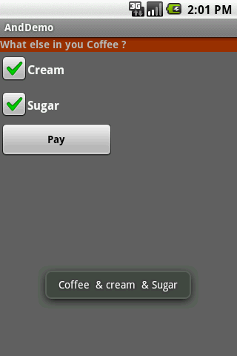
Android GUI Programming
Basic Widgets: CheckBox
A checkbox is a specific type of two-states button that can be either checked or unchecked. A example usage of a checkbox inside your activity would be the following:

Slide 37
Android GUI Programming
Example: Basic Widgets: CheckBox
Complete code for the checkBox demo:
Layout: main.xml
<?xml version="1.0" encoding="utf-8"?>
<LinearLayout
android:id="@+id/linearLayout"
android:layout_width="fill_parent"
android:layout_height="fill_parent"
android:background="#ff666666”
<CheckBox
android:id="@+id/chkCream"
android:layout_width="wrap_content"
android:layout_height="wrap_content"
android:text="Cream"
android:textStyle="bold"
>
</CheckBox>

Slide 38
Android GUI Programming
Example: Basic Widgets: CheckBox
Complete code for the checkBox demo:
Layout: main.xml
android:orientation="vertical"
xmlns:android="http://schemas.android.com/apk/res/android"
><TextView
android:id="@+id/labelCoffee"
android:layout_width="fill_parent"
android:layout_height="wrap_content”
<CheckBox
android:id="@+id/chkSugar"
android:layout_width="wrap_content"
android:layout_height="wrap_content"
android:text="Sugar"
android:textStyle="bold"
>
</CheckBox>

Slide 39
Android GUI Programming
Example: Basic Widgets: CheckBox
Complete code for the checkBox demo:
Layout: main.xml
android:background="#ff993300"
android:text="What else in you Coffee ?"
android:textStyle="bold"
>
</TextView>
<Button
android:id="@+id/btnPay"
android:layout_width="153px"
android:layout_height="wrap_content"
android:text="Pay"
android:textStyle="bold"
>
</Button>
</LinearLayout>

Slide 40
Android GUI Programming
Example: Basic Widgets: CheckBox
Complete code for the checkBox demo:
import android.view.View.OnClickListener;
import android.widget.Button;
import android.widget.CheckBox;
import android.widget.Toast;
public class AndDemo extends Activity {
CheckBox chkCream;
CheckBox chkSugar;
Button btnPay;
@Override
public void onCreate(Bundle savedInstanceState) {
super.onCreate(savedInstanceState);
setContentView(R.layout.main);

Slide 41
Android GUI Programming
Example: Basic Widgets: CheckBox
Complete code for the checkBox demo:
//binding XMl controls with Java code
chkCream = (CheckBox)findViewById(R.id.chkCream);
chkSugar = (CheckBox)findViewById(R.id.chkSugar);
btnPay = (Button) findViewById(R.id.btnPay);
//LISTENER: wiring button-events-&-code
btnPay.setOnClickListener(new OnClickListener() {
@Override
public void onClick(View v) {
String msg = "Coffee ";
if (chkCream.isChecked()) {
msg += " & cream ";
}

Slide 42
Android GUI Programming
Example: Basic Widgets: CheckBox
Complete code for the checkBox demo:
if (chkSugar.isChecked()){
msg += " & Sugar";
}
Toast.makeText(getApplicationContext(),
msg, Toast.LENGTH_SHORT).show();
//go now and compute cost...
}//onClick
});
}//onCreate
}//class

Slide 43
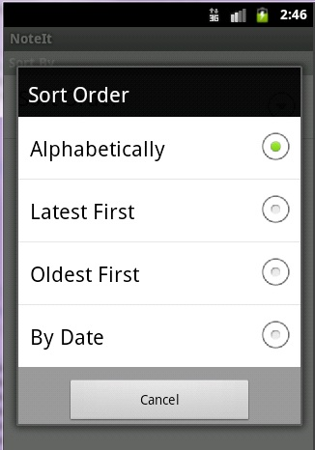
Android GUI Programming
Basic Widgets: RadioButtons
A radio button is a two-states button that can be either checked or unchecked.

Slide 44
Android GUI Programming
Basic Widgets: RadioButtons
When the radio button is unchecked, the user can press or click it to
check it.
Radio buttons are normally used together in a RadioGroup.
When several radio buttons live inside a radio group, checking one radio
button unchecks all the others.

Slide 45
Android GUI Programming
Basic Widgets: RadioButtons
RadioButton inherits from … TextView. Hence, all the standard TextView
properties for font face, style, color, etc. are available for controlling the
look of radio buttons.
Similarly, you can call isChecked() on a RadioButton to see if it is
selected, toggle() to select it, and so on, like you can with a CheckBox.

Slide 46
Android GUI Programming
Example: Basic Widgets: RadioButtons
We extend the previous example by adding a RadioGroup and three RadioButtons. Only new XML and Java code is shown:
<?xml version="1.0"encoding="utf-8"?>
<LinearLayout
android:id="@+id/myLinearLayout"
android:layout_width="fill_parent"
android:layout_height="fill_parent"
android:orientation="vertical"
xmlns:android="http://schemas.android.com/apk/res/android"
>
<RadioGroup
android:id="@+id/radGroupCoffeeType"
android:layout_width="fill_parent"
android:layout_height="wrap_content”

Slide 47
Android GUI Programming
Example: Basic Widgets: RadioButtons
We extend the previous example by adding a RadioGroup and three RadioButtons. Only new XML and Java code is shown:
android:orientation="vertical"
>
<TextView
android:id="@+id/labelCoffeeType"
android:layout_width="fill_parent"
android:layout_height="wrap_content"
android:background="#ff993300"
android:text="What type of coffee?"
android:textStyle="bold"
>
</TextView>
<RadioButton

Slide 48
Android GUI Programming
Example: Basic Widgets: RadioButtons
We extend the previous example by adding a RadioGroup and three RadioButtons. Only new XML and Java code is shown:
android:id="@+id/radDecaf"
android:layout_width="fill_parent"
android:layout_height="wrap_content"
android:text="Decaf"
>
</RadioButton>
<RadioButton
android:id="@+id/radExpresso"
android:layout_width="wrap_content"
android:layout_height="wrap_content"
android:text="Expresso"
>

Slide 49
Android GUI Programming
Example: Basic Widgets: RadioButtons
We extend the previous example by adding a RadioGroup and three RadioButtons. Only new XML and Java code is shown:
</RadioButton>
<RadioButton
android:id="@+id/radColombian"
android:layout_width="wrap_content"
android:layout_height="wrap_content"
android:text="Colombian"
>
</RadioButton>
</RadioGroup>
...
</LinearLayout>

Slide 50
Android GUI Programming
Example: Basic Widgets: RadioButtons
Android Activity
Package cis493.demoui;
// example using RadioButtons
Import android.app.Activity;
Import android.os.Bundle;
Import android.view.View;
Import android.view.View.OnClickListener;
Import android.widget.Button;
Import android.widget.CheckBox;
Import android.widget.RadioButton;
Import android.widget.RadioGroup;
Import android.widget.Toast;
Public class AndDemoUIextendsActivity {

Slide 51
Android GUI Programming
Example: Basic Widgets: RadioButtons
Android Activity
CheckBox chkCream;
CheckBox chkSugar;
Button btnPay;
RadioGroup radCoffeeType;
RadioButton radDecaf;
RadioButton radExpresso;
RadioButton radColombian;
@Override
publicvoidonCreate(Bundle savedInstanceState) {
super.onCreate(savedInstanceState);
setContentView(R.layout.main);
//binding XMlcontrols to Java code

Slide 52
Android GUI Programming
Example: Basic Widgets: RadioButtons
Android Activity
chkCream= (CheckBox)findViewById(R.id.chkCream);
chkSugar= (CheckBox)findViewById(R.id.chkSugar);
btnPay= (Button) findViewById(R.id.btnPay);
radCoffeeType= (RadioGroup)findViewById(R.id.radGroupCoffeeType);
radDecaf= (RadioButton)findViewById(R.id.radDecaf);
radExpresso= (RadioButton)findViewById(R.id.radExpresso);
radColombian= (RadioButton)findViewById(R.id.radColombian);
//LISTENER: wiring button-events-&-code
btnPay.setOnClickListener(newOnClickListener() {
@Override
publicvoidonClick(View v) {

Slide 53
Android GUI Programming
Example: Basic Widgets: RadioButtons
Android Activity
String msg= "Coffee ";
if(chkCream.isChecked())
msg+= " & cream ";
if(chkSugar.isChecked())
msg+= " & Sugar";
// get radio buttons ID number
intradioId= radCoffeeType.getCheckedRadioButtonId();
// compare selected'sId with individual RadioButtonsID
if(radColombian.getId()== radioId)
msg= “Colombian " + msg;
// similarly you may use .isChecked() on each RadioButton
if(radExpresso.isChecked())

Slide 54
Android GUI Programming
Example: Basic Widgets: RadioButtons
Android Activity
msg= "Expresso" + msg;
Toast.makeText(getApplicationContext(), msg, Toast.LENGTH_SHORT).show();
// go now and compute cost...
}// onClick
});
}// onCreate
}// class

Slide 55
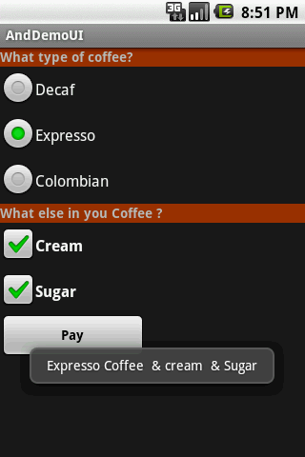
Android GUI Programming
Example: Basic Widgets: RadioButtons
This UI uses RadioButtons and CheckBoxe to define choices

Slide 56
Android GUI Programming
UI Other Features
All widgets extend View therefore they acquire a number of useful View properties and methods including:
XML Controls the focus sequence:
android:visibility
Android:background
Java methods:
myButton.requestFocus()
myTextBox.isFocused()
myWidget.setEnabled()
myWidget.isEnabled()

Slide 57
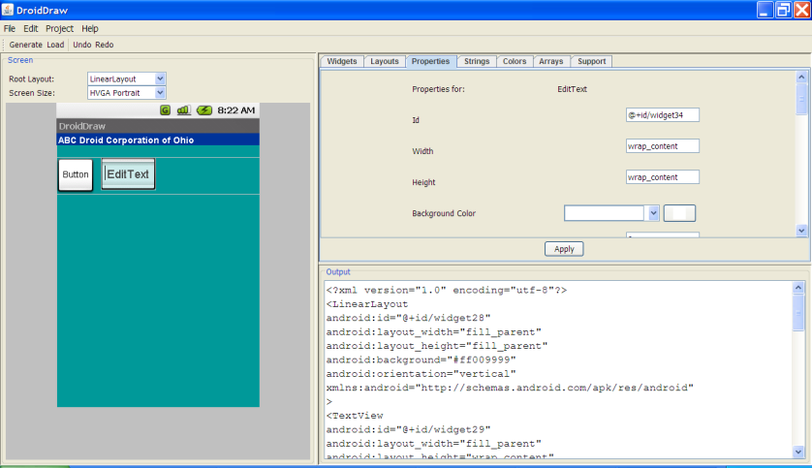
Android GUI Programming
UI Other Features
Resource: DroidDraw - www.droidDraw.org

Slide 58
Android GUI Programming
UI Other Features
Resource: DroidDraw - www.droidDraw.org
AAS Link: http://code.google.com/p/android-ui-utils/
Icon Genhttp://android-ui-utils.googlecode.com/hg/asset-studio/dist/index.html
Pencil 1.2http://pencil.evolus.vn/en-US/Home.aspx
Video: http://www.youtube.com/watch?v=EaT7sYr_f0k&feature=player_embedded
WARNING: These utilities are currently in beta.
Utilities that help in the design and development ofAndroid application user interfaces. This library currently consists of three individual tools for designers and developers:

Slide 59
Android GUI Programming
UI Other Features
Resource: DroidDraw - www.droidDraw.org
UI Prototyping Stencils
A set of stencils for the Pencil GUI prototyping tool, which is available as an add-on for Firefox or as a standalone download.
Android Asset Studio
Try out the beta version:Android Asset Studio (shortlink: http://j.mp/androidassetstudio)
A web-based set of tools for generating graphics and other assets that would eventually be in an Android application's res/directory.
Currently available asset generators area available for:
Launcher icons
Menu icons

Slide 60
Android GUI Programming
UI Other Features
Resource: DroidDraw - www.droidDraw.org
Tab icons
Notification icons
Support for creation of XML resources and nine-patches is planned for a future release.
Android Icon Templates
A set of Photoshop icon templates that follow the icon design guidelines, complementing the official Android Icon Templates Pack.

